Slide 1
Chapter 5 The Binomial Coefficients
Zhou Xiaoyu zhouxy@seu.edu.cn
room 427, Building of School of Computer Science & Engineering

Slide 2
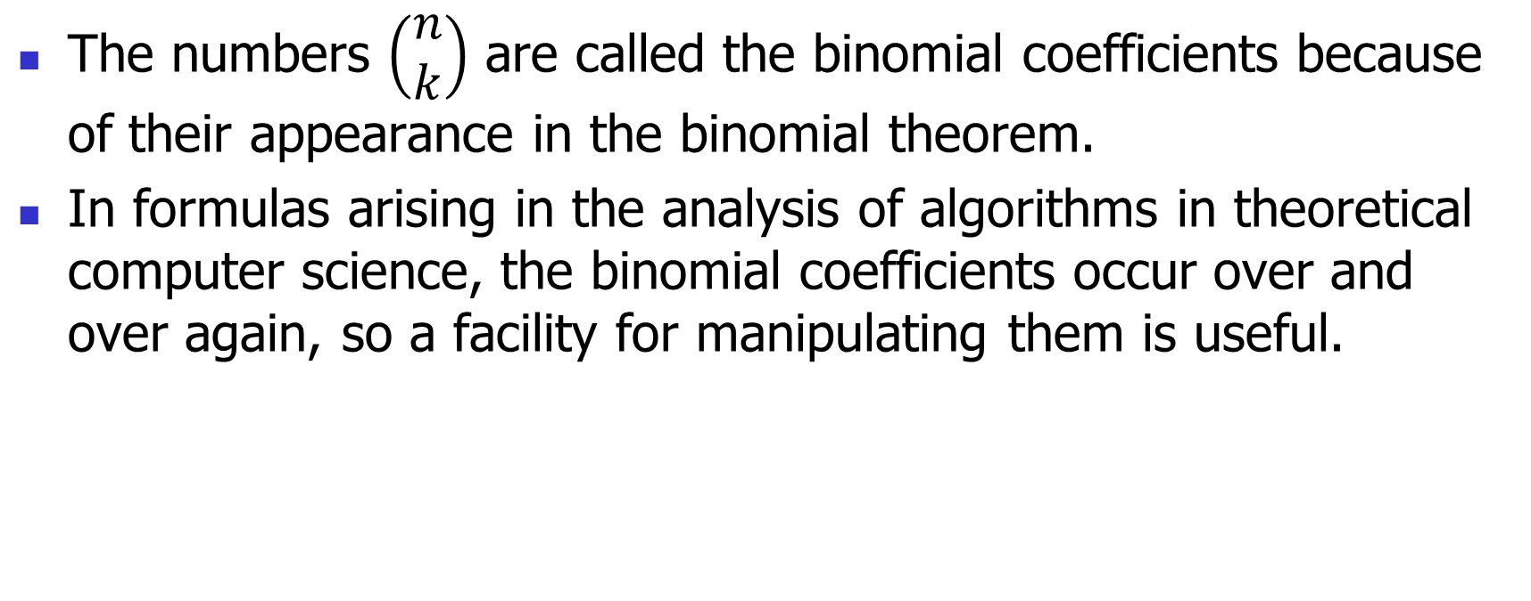
Binomial Coefficients
The numbers $\left(\begin{matrix}n \\ k\end{matrix}\right)$ are called the binomial coefficients because of their appearance in the binomial theorem.
In formulas arising in the analysis of algorithms in theoretical computer science, the binomial coefficients occur over and over again, so a facility for manipulating them is useful.

Slide 3
5.2 The Binomial Theorem

Slide 4
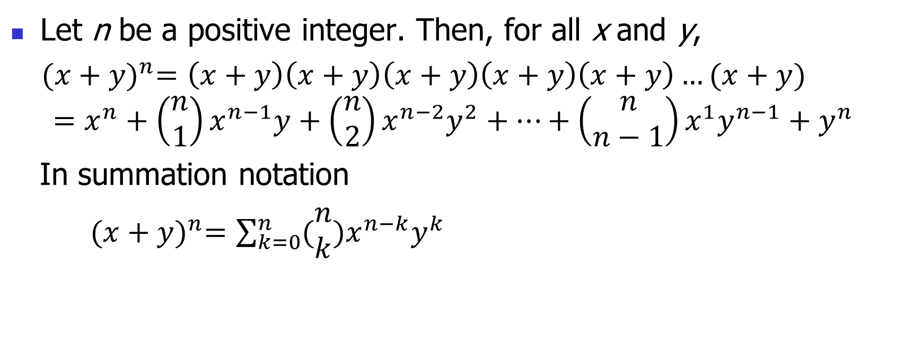
Theorem 5.2.1
Let n be a positive integer. Then, for all x and y,
${(x+y)}^{n}=\left(x+y\right)\left(x+y\right)\left(x+y\right)\left(x+y\right)\left(x+y\right)…(x+y)$
$$=x^{n}+\left(\begin{matrix}n \\ 1\end{matrix}\right)x^{n−1}y+\left(\begin{matrix}n \\ 2\end{matrix}\right)x^{n−2}y^{2}+…+\left(\begin{matrix}n \\ n−1\end{matrix}\right)x^{1}y^{n−1}+y^{n}$$
In summation notation
${(x+y)}^{n}=\sum_{k=0}^{n}{(\begin{matrix}n \\ k\end{matrix})x^{n−k}y^{k}}$

Slide 5
Theorem 5.2.1
First proof
Combinatorial
Second proof (for self study)
Inductive
Please refer to the proof on page 131 (144/618) of the textbook.

Slide 6
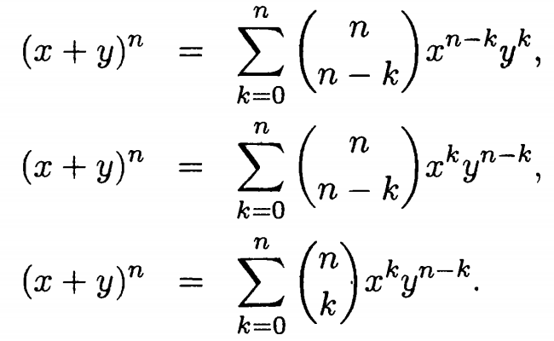
Several Other Equivalent Forms of the Binomial Theorem

Slide 7

Theorem 5.2.2
Let n be a positive integer. Then, for all x, ${(1+x)}^{n}=\sum_{k=0}^{n}{(\begin{matrix}n \\ k\end{matrix})x^{k}}=\sum_{k=0}^{n}{(\begin{matrix}n \\ n−k\end{matrix})x^{k}}$

Slide 8
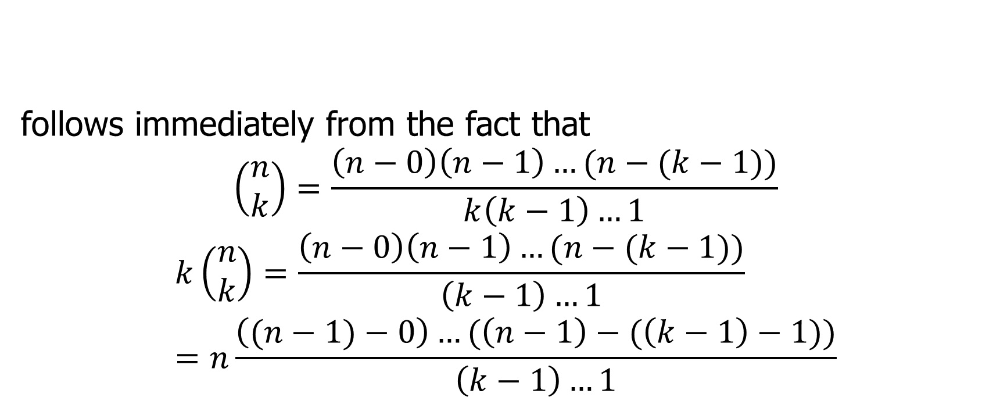
Some Additional Identities (no need to remember)
follows immediately from the fact that
$$\left(\begin{matrix}n \\ k\end{matrix}\right)=\frac{\left(n−0\right)\left(n−1\right)…(n−(k−1))}{k\left(k−1\right)…1}$$
$$k\left(\begin{matrix}n \\ k\end{matrix}\right)=\frac{\left(n−0\right)\left(n−1\right)…(n−(k−1))}{\left(k−1\right)…1}=n\frac{\left((n−1)−0\right)…(\left(n−1\right)−(\left(k−1\right)−1))}{\left(k−1\right)…1}$$

Slide 9
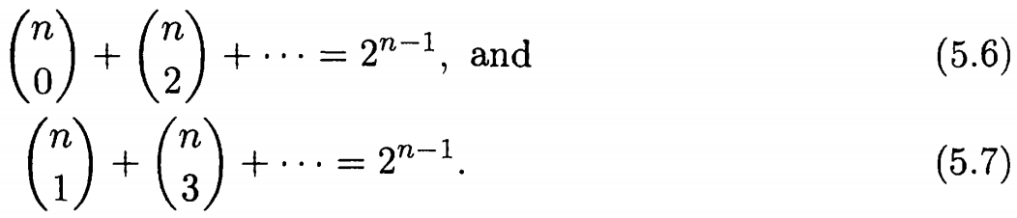
Some Additional Identities

Slide 10
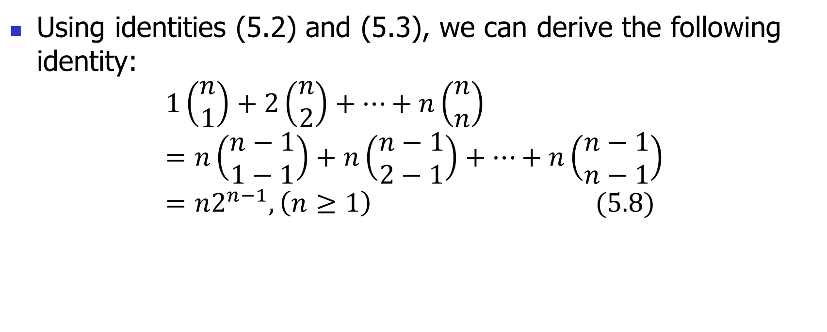
Some Additional Identities (neglected for this course)
Using identities (5.2) and (5.3), we can derive the following identity:
$$1\left(\begin{matrix}n \\ 1\end{matrix}\right)+2\left(\begin{matrix}n \\ 2\end{matrix}\right)+…+n\left(\begin{matrix}n \\ n\end{matrix}\right)=n\left(\begin{matrix}n−1 \\ 1−1\end{matrix}\right)+n\left(\begin{matrix}n−1 \\ 2−1\end{matrix}\right)+…+n\left(\begin{matrix}n−1 \\ n−1\end{matrix}\right)=n2^{n−1}, \left(n≥1\right) (5.8)$$

Slide 11
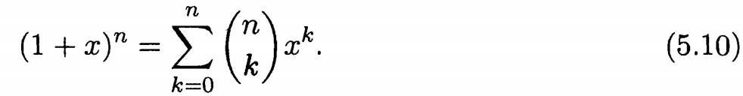
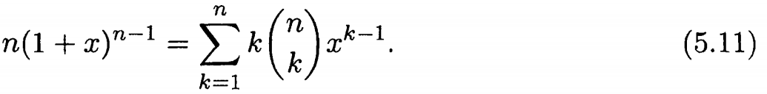
Some Additional Identities (neglected for this course)
Differentiating both sides of (5.10) with respect to x, we get

Slide 12
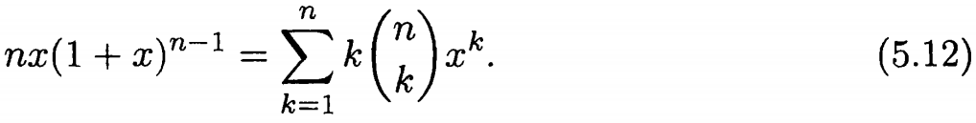
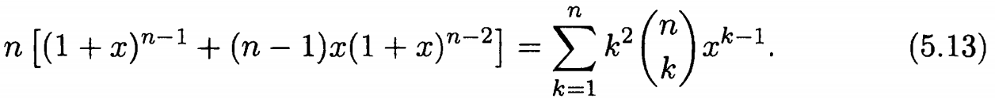
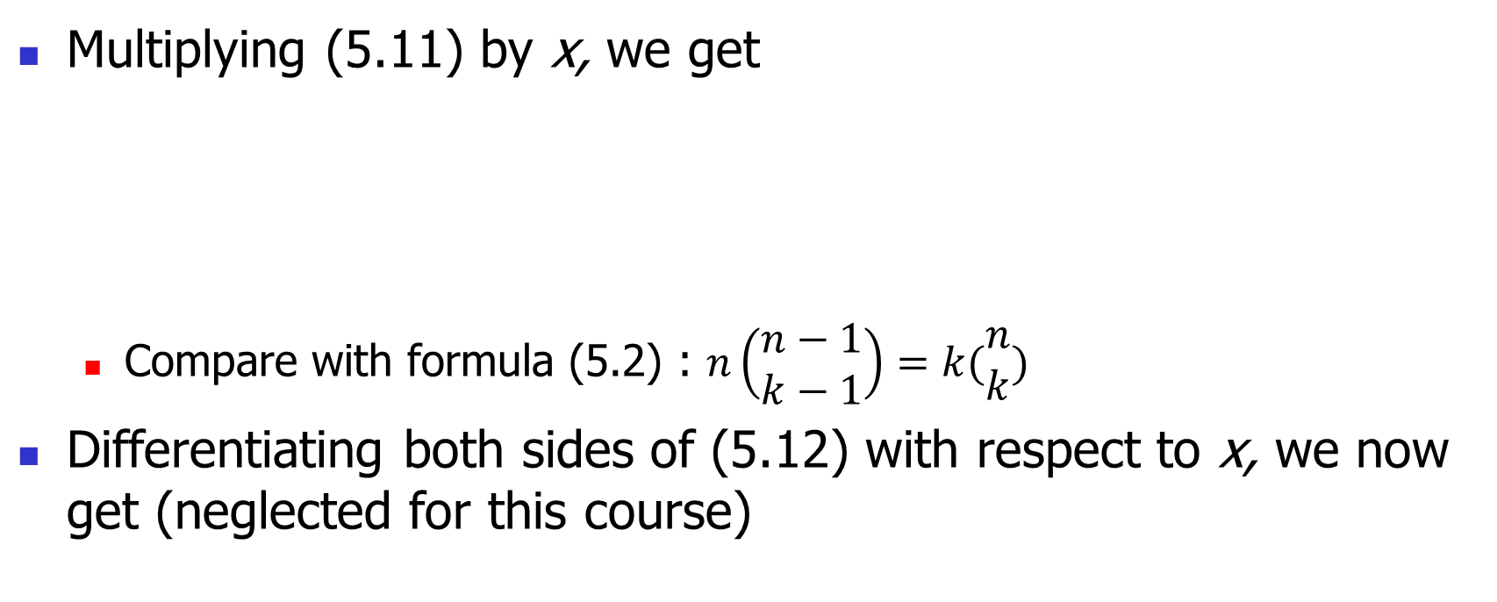
Some Additional Identities (neglected for this course)
Multiplying (5.11) by x, we get
Compare with formula (5.2) : $n\left(\begin{matrix}n−1 \\ k−1\end{matrix}\right)=k(\begin{matrix}n \\ k\end{matrix})$
Differentiating both sides of (5.12) with respect to x, we now get (neglected for this course)

Slide 13

Some Additional Identities (neglected for this course)
By alternately differentiating with respect to x and multiplying by x, starting from (5.10), we can obtain an identity for $\sum_{k=1}^{n}{k^{p}(\begin{matrix}n \\ k\end{matrix}) }$for any positive integer p.

Slide 14
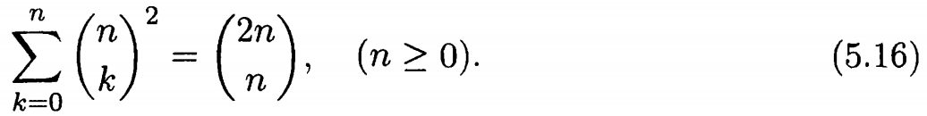
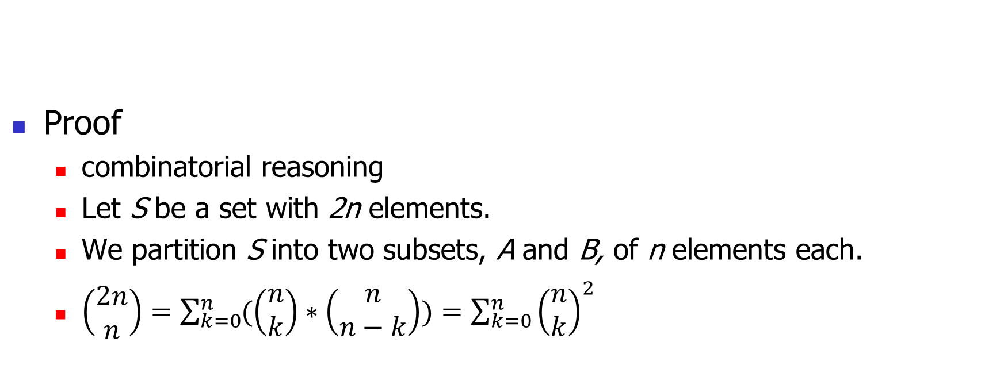
Some Additional Identities
Proof
combinatorial reasoning
Let S be a set with 2n elements.
We partition S into two subsets, A and B, of n elements each.
$\left(\begin{matrix}2n \\ n\end{matrix}\right)=\sum_{k=0}^{n}{(\left(\begin{matrix}n \\ k\end{matrix}\right)∗\left(\begin{matrix}n \\ n−k\end{matrix}\right))}=\sum_{k=0}^{n}{{\left(\begin{matrix}n \\ k\end{matrix}\right)}^{2}}$

Slide 15
5.5 Newton's Binomial Theorem

Slide 16
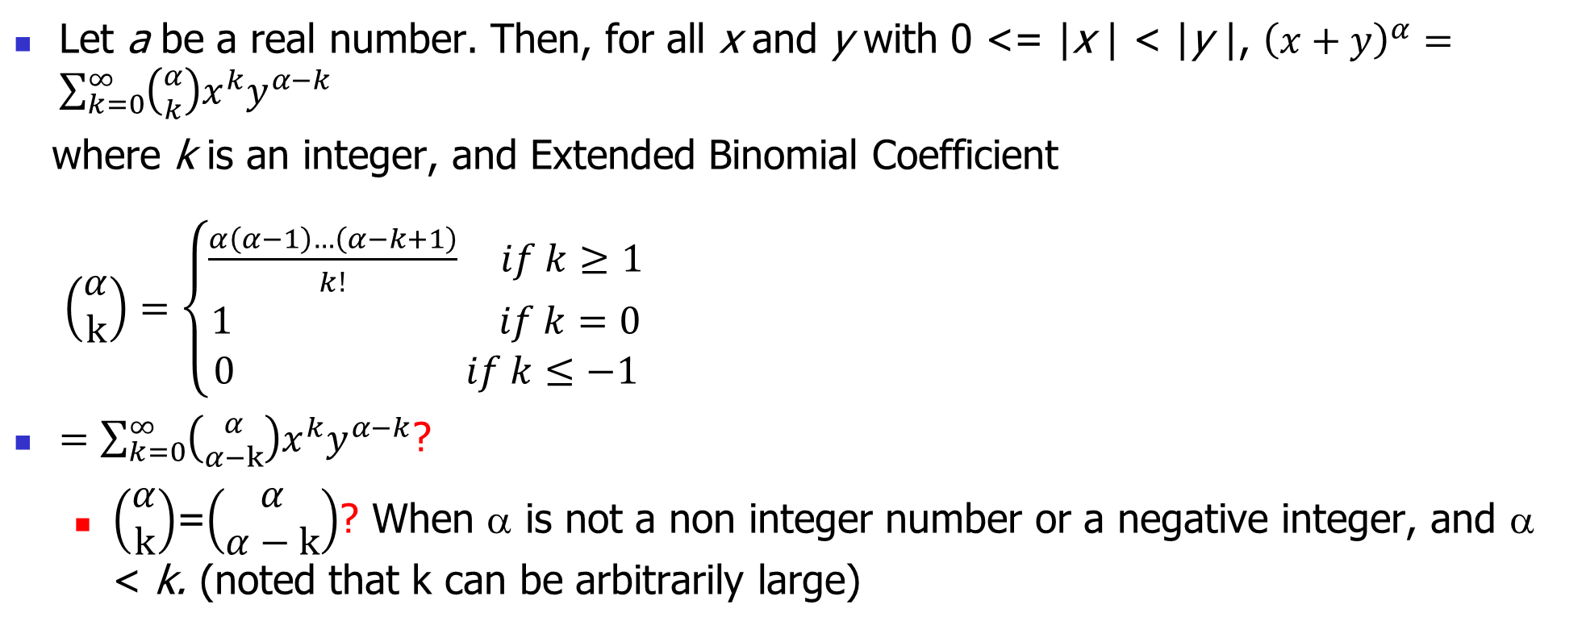
Theorem 5.5.1 (1676, by Isaac Newton)
Let a be a real number. Then, for all x and y with 0 <= |x | < |y |, ${\left(x+y\right)}^{α}=\sum_{k=0}^{∞}{\left({α \atop k}\right){x^{k}y}^{α−k}}$
where k is an integer, and Extended Binomial Coefficient
$\left(\begin{matrix}α \\ k\end{matrix}\right)=\left\{\begin{matrix}\frac{α\left(α−1\right)…\left(α−k+1\right)}{k!} if k≥1 \\ 1 if k=0 \\ 0 if k≤−1\end{matrix}\right.$
$=\sum_{k=0}^{∞}{\left({α \atop α−k}\right){x^{k}y}^{α−k}}$?
$\left(\begin{matrix}α \\ k\end{matrix}\right)$=$\left(\begin{matrix}α \\ α−k\end{matrix}\right)$? When α is not a non integer number or a negative integer, and α < k. (noted that k can be arbitrarily large)

Slide 17
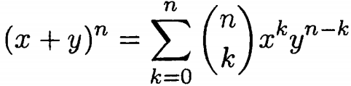

Newton's Binomial Theorem
If α is a positive integer n, then for k > n, $\left(\begin{matrix}n \\ k\end{matrix}\right)$ = 0, and the preceding expansion becomes

Slide 18
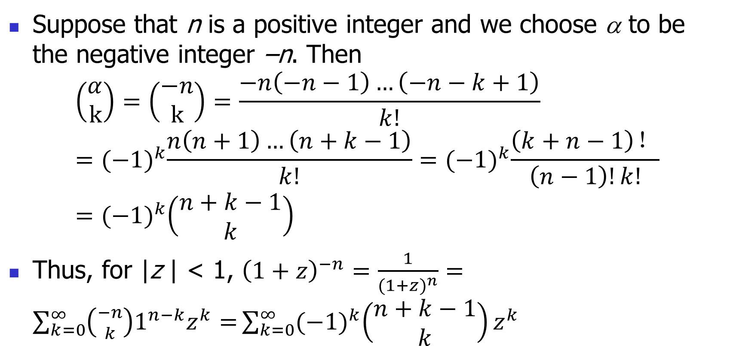
Combination Number of Negative Integer
Suppose that n is a positive integer and we choose α to be the negative integer –n. Then
$$\left(\begin{matrix}α \\ k\end{matrix}\right)=\left(\begin{matrix}−n \\ k\end{matrix}\right)=\frac{−n\left(−n−1\right)…\left(−n−k+1\right)}{k!}={(−1)}^{k}\frac{n\left(n+1\right)…\left(n+k−1\right)}{k!}={(−1)}^{k}\frac{\left(k+n−1\right)！}{\left(n−1\right)!k!}={(−1)}^{k}\left(\begin{matrix}n+k−1 \\ k\end{matrix}\right)$$
Thus, for |z | < 1, ${\left(1+z\right)}^{−n}=\frac{1}{({1+z)}^{n}}=\sum_{k=0}^{∞}{\left({−n \atop k}\right)1^{n−k}z^{k}=}\sum_{k=0}^{∞}{{(−1)}^{k}\left(\begin{matrix}n+k−1 \\ k\end{matrix}\right)z^{k}}$

Slide 19
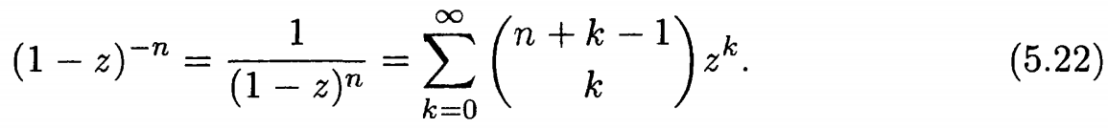
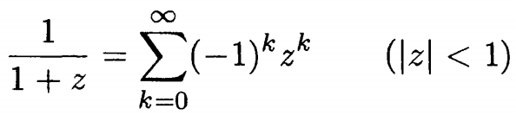
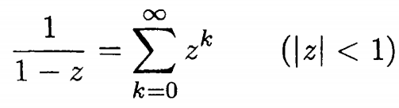

Combination Number of Negative Integer
Replacing z by -z, we obtain
If n = 1, then $\left(\begin{matrix}n+k −1 \\ k\end{matrix}\right)$ = $\left(\begin{matrix}k \\ k\end{matrix}\right)$ = 1, and we obtain

Slide 20
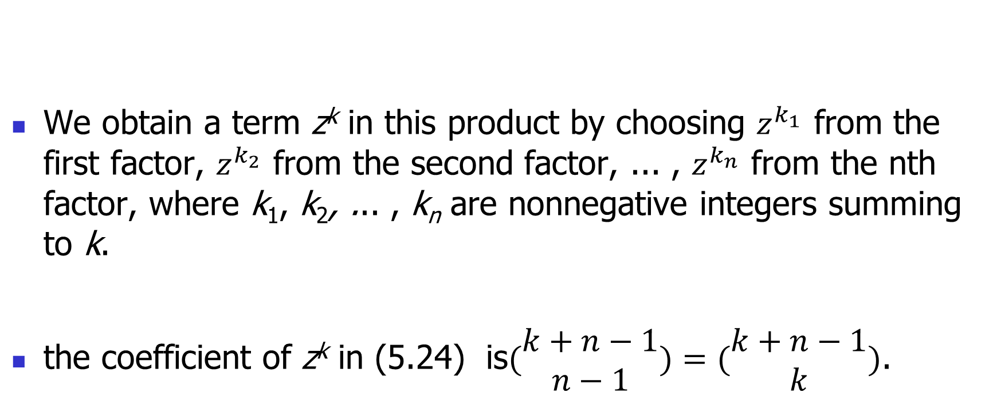
Combinatorial Derivation of (5.22)
We obtain a term z^{k} in this product by choosing $z^{k_{1}}$ from the first factor, $z^{k_{2}}$ from the second factor, ... , $z^{k_{n}}$ from the nth factor, where k₁, k₂, ... , k_{n} are nonnegative integers summing to k.
the coefficient of z^{k} in (5.24) is$(\begin{matrix}k+n−1 \\ n−1\end{matrix})=(\begin{matrix}k+n−1 \\ k\end{matrix})$.

Slide 21
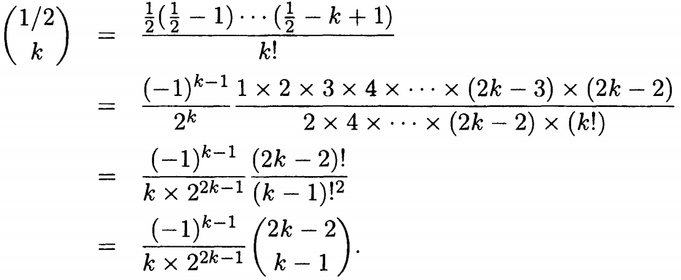

Calculation of Square Roots (neglected for this course)
${(1+z)}^{1/2}= \sum_{k=0}^{∞}{\left(\begin{matrix}1/2 \\ k\end{matrix}\right)z^{k}, where |z|<1.}$
$\left(\begin{matrix}1/2 \\ 0\end{matrix}\right)=1$

Slide 22
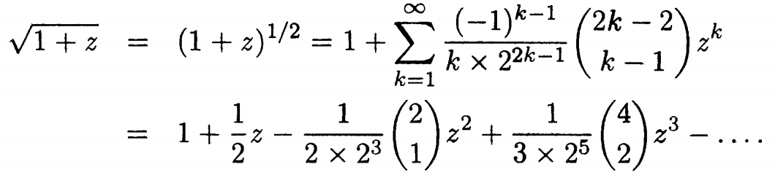
Calculation of Square Roots (neglected for this course)
Thus, for |z | < 1,

Slide 23
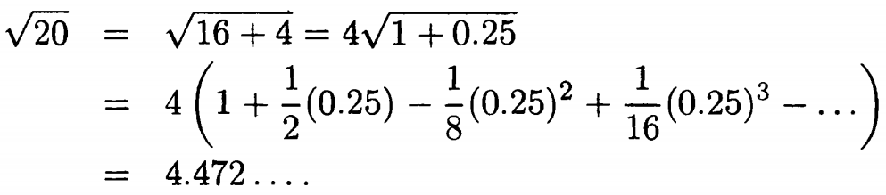
Calculation of Square Roots (neglected for this course)
For example,

Slide 24
5.1 recurrence relation: Pascal's Triangle

Slide 25
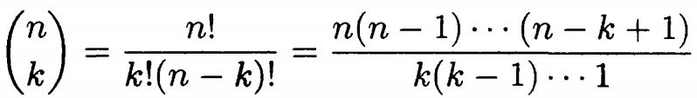
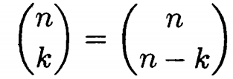
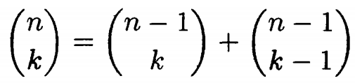
Pascal’s Formula
Pascal’s formula

Slide 26
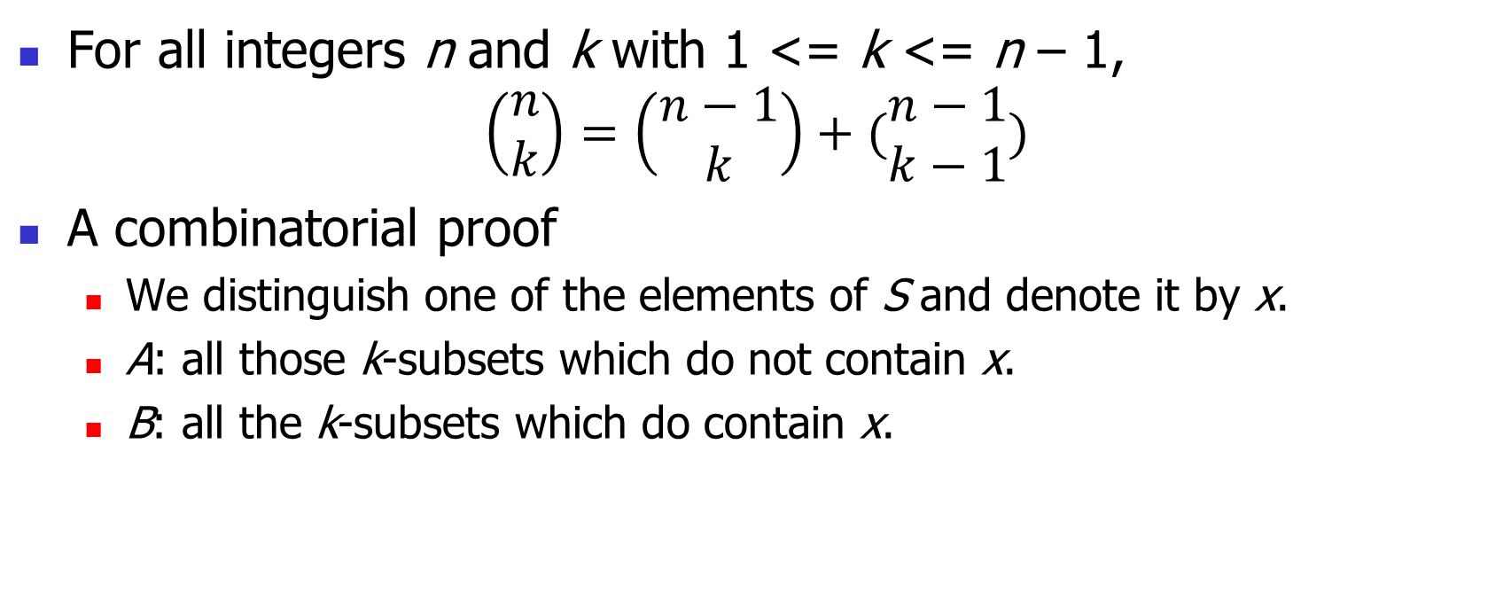
Theorem 2.3.3 (Pascal's formula)
For all integers n and k with 1 <= k <= n – 1,
$$\left(\begin{matrix}n \\ k\end{matrix}\right)=\left(\begin{matrix}n−1 \\ k\end{matrix}\right)+(\begin{matrix}n−1 \\ k−1\end{matrix})$$
A combinatorial proof
We distinguish one of the elements of S and denote it by x.
A: all those k-subsets which do not contain x.
B: all the k-subsets which do contain x.

Slide 27
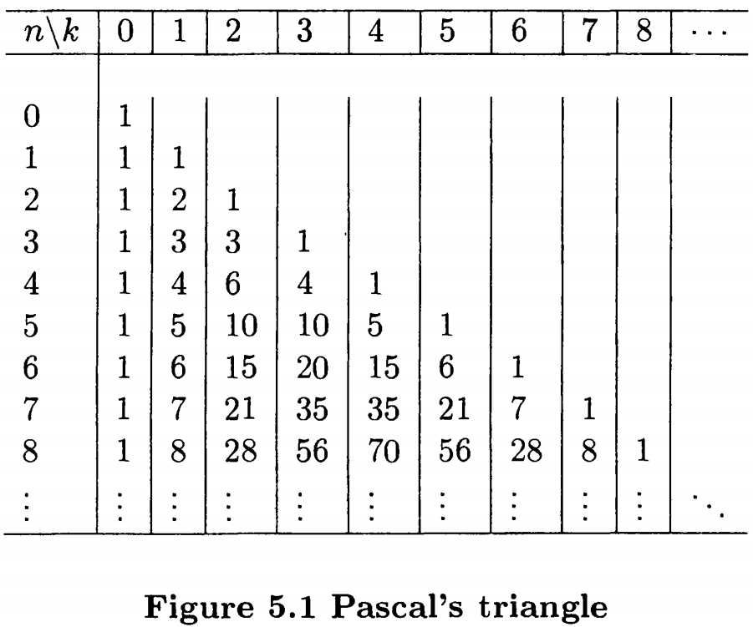
Pascal’s Triangle
Notes:
Tetrahedral 四面体

Slide 28
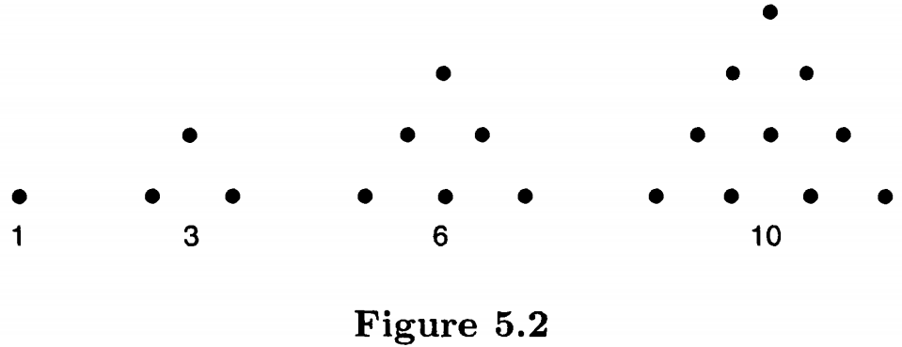
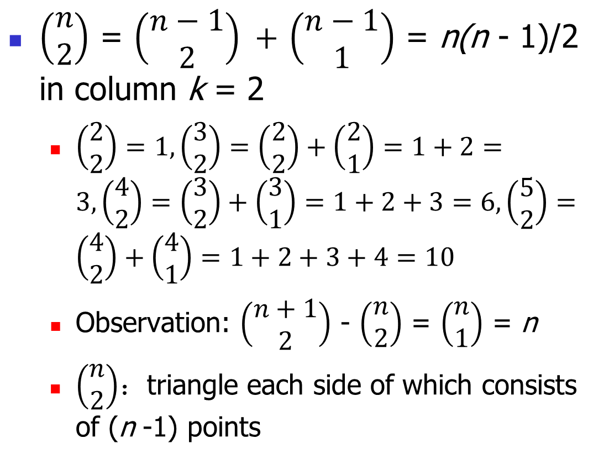
Triangular Numbers
$\left(\begin{matrix}n \\ 2\end{matrix}\right)$ = $\left(\begin{matrix}n−1 \\ 2\end{matrix}\right) +$ $\left(\begin{matrix}n−1 \\ 1\end{matrix}\right)$ = n(n - 1)/2 in column k = 2
$\left(\begin{matrix}2 \\ 2\end{matrix}\right)=1,\left(\begin{matrix}3 \\ 2\end{matrix}\right)=\left(\begin{matrix}2 \\ 2\end{matrix}\right)+\left(\begin{matrix}2 \\ 1\end{matrix}\right)=1+2=3,\left(\begin{matrix}4 \\ 2\end{matrix}\right)=\left(\begin{matrix}3 \\ 2\end{matrix}\right)+\left(\begin{matrix}3 \\ 1\end{matrix}\right)=1+2+3=6,\left(\begin{matrix}5 \\ 2\end{matrix}\right)=\left(\begin{matrix}4 \\ 2\end{matrix}\right)+\left(\begin{matrix}4 \\ 1\end{matrix}\right)=1+2+3+4=10$
Observation: $\left(\begin{matrix}n+1 \\ 2\end{matrix}\right)$ - $\left(\begin{matrix}n \\ 2\end{matrix}\right)$ = $\left(\begin{matrix}n \\ 1\end{matrix}\right)$ = n
$\left(\begin{matrix}n \\ 2\end{matrix}\right)$：triangle each side of which consists of (n -1) points

Slide 29
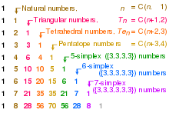
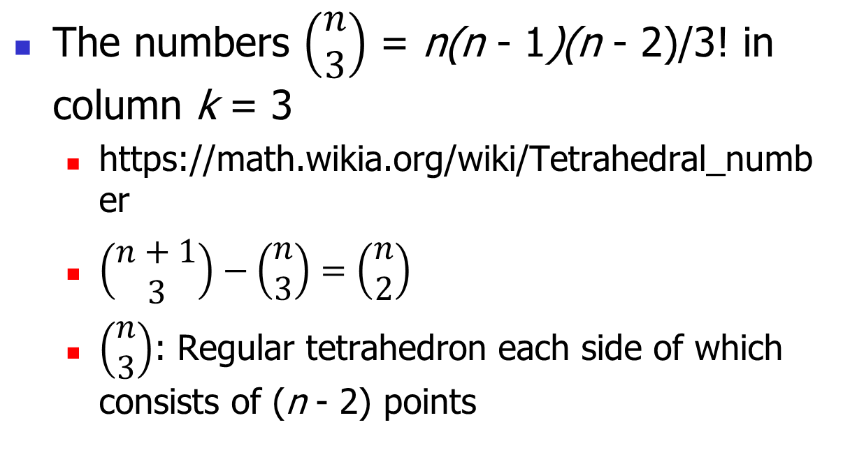
Tetrahedral Numbers
The numbers $\left(\begin{matrix}n \\ 3\end{matrix}\right)$ = n(n - 1)(n - 2)/3! in column k = 3
https://math.wikia.org/wiki/Tetrahedral_number
$\left(\begin{matrix}n+1 \\ 3\end{matrix}\right)−\left(\begin{matrix}n \\ 3\end{matrix}\right)=\left(\begin{matrix}n \\ 2\end{matrix}\right)$
$\left(\begin{matrix}n \\ 3\end{matrix}\right)$: Regular tetrahedron each side of which consists of (n - 2) points

Slide 30
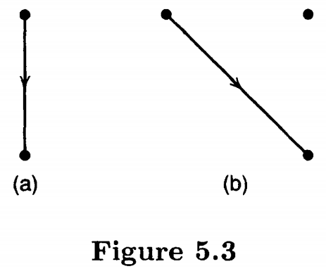
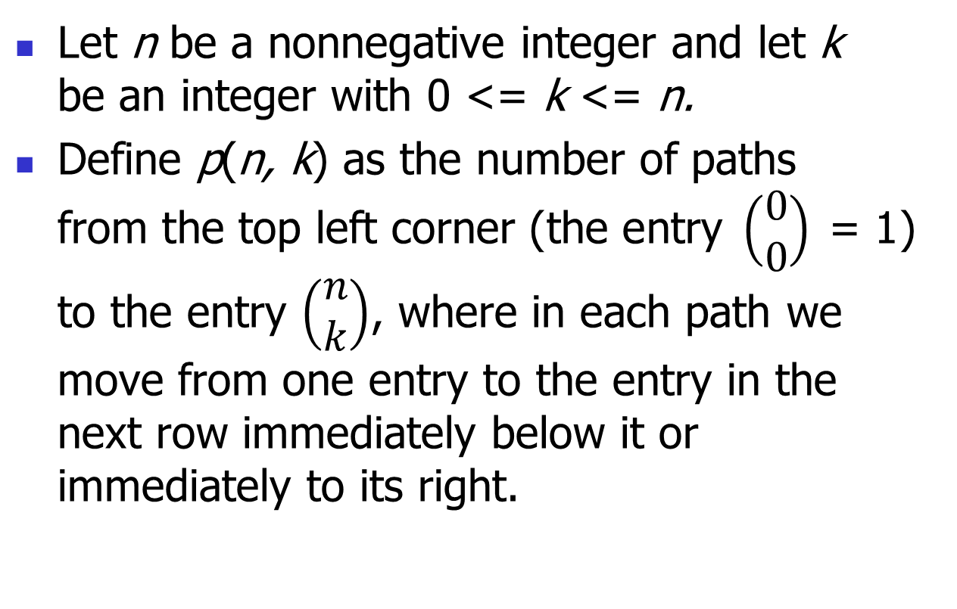
Combination Number as Number of Paths in Pascal's Triangle
Let n be a nonnegative integer and let k be an integer with 0 <= k <= n.
Define p(n, k) as the number of paths from the top left corner (the entry $\left(\begin{matrix}0 \\ 0\end{matrix}\right)$ = 1) to the entry $\left(\begin{matrix}n \\ k\end{matrix}\right)$, where in each path we move from one entry to the entry in the next row immediately below it or immediately to its right.

Slide 31
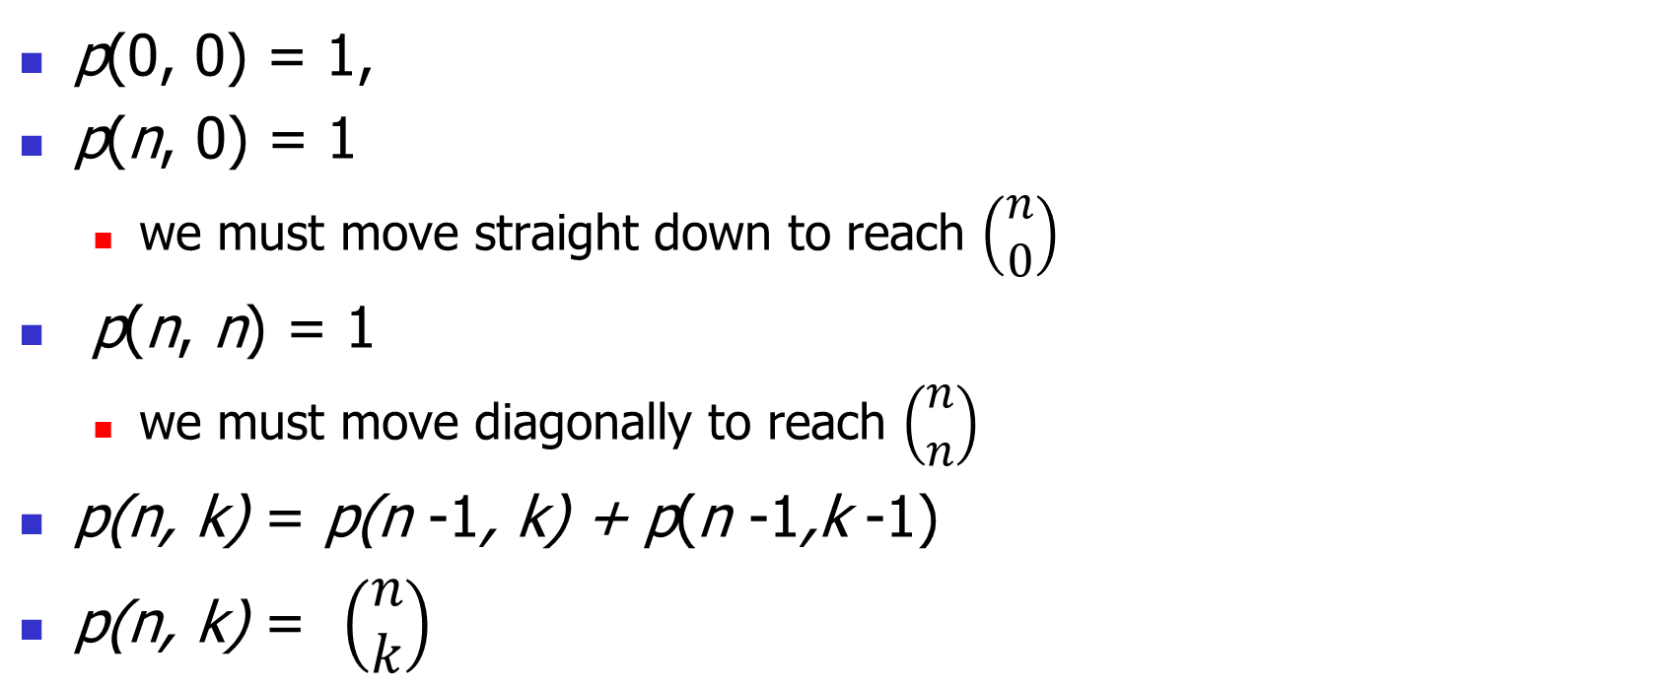
Another Interpretation to the Entries of Pascal's Triangle
p(0, 0) = 1,
p(n, 0) = 1
we must move straight down to reach $\left(\begin{matrix}n \\ 0\end{matrix}\right)$
p(n, n) = 1
we must move diagonally to reach $\left(\begin{matrix}n \\ n\end{matrix}\right)$
p(n, k) = p(n -1, k) + p(n -1,k -1)
p(n, k) = $\left(\begin{matrix}n \\ k\end{matrix}\right)$

Slide 32
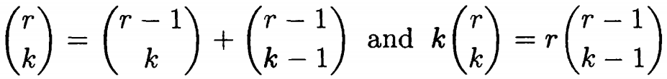
Extended Binomial Coefficient
Pascal's formula and formula (5.2), namely
are now valid for all r and k.

Slide 33
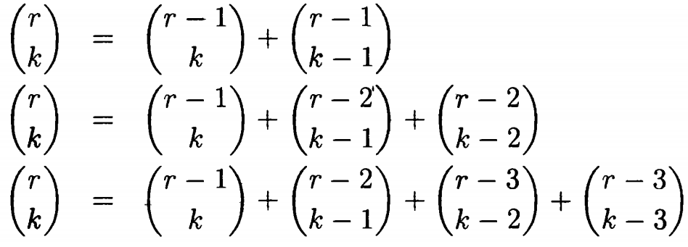
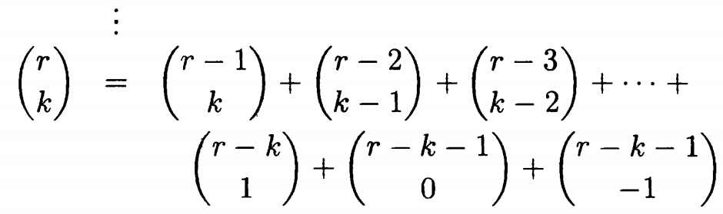
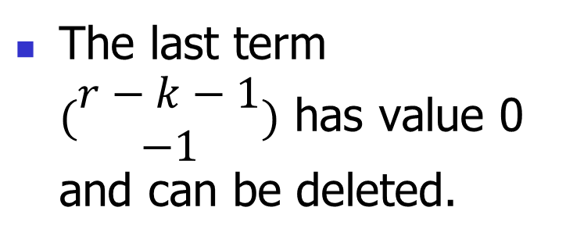
Formula 5.18
The last term $(\begin{matrix}r−k−1 \\ −1\end{matrix})$ has value 0 and can be deleted.

Slide 34
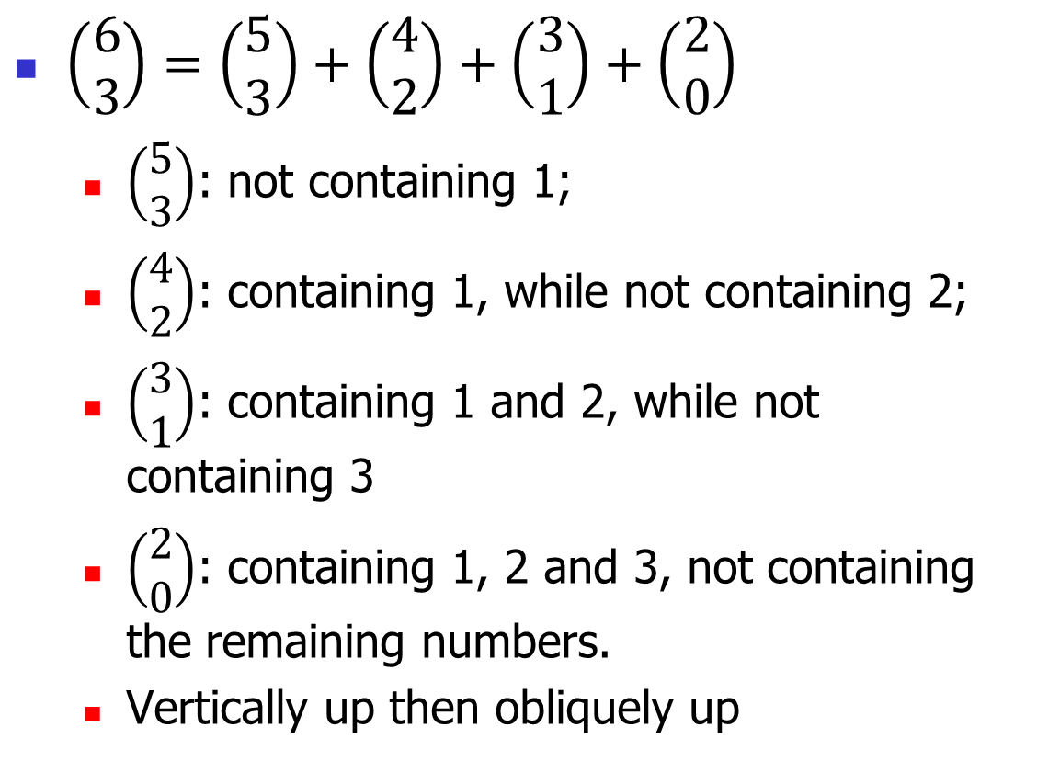
Intuitional Interpretation of Formula 5.18
$\left(\begin{matrix}6 \\ 3\end{matrix}\right)=\left(\begin{matrix}5 \\ 3\end{matrix}\right)+\left(\begin{matrix}4 \\ 2\end{matrix}\right)+\left(\begin{matrix}3 \\ 1\end{matrix}\right)+\left(\begin{matrix}2 \\ 0\end{matrix}\right)$
$\left(\begin{matrix}5 \\ 3\end{matrix}\right)$: not containing 1;
$\left(\begin{matrix}4 \\ 2\end{matrix}\right)$: containing 1, while not containing 2;
$\left(\begin{matrix}3 \\ 1\end{matrix}\right)$: containing 1 and 2, while not containing 3
$\left(\begin{matrix}2 \\ 0\end{matrix}\right)$: containing 1, 2 and 3, not containing the remaining numbers.
Vertically up then obliquely up

Slide 35
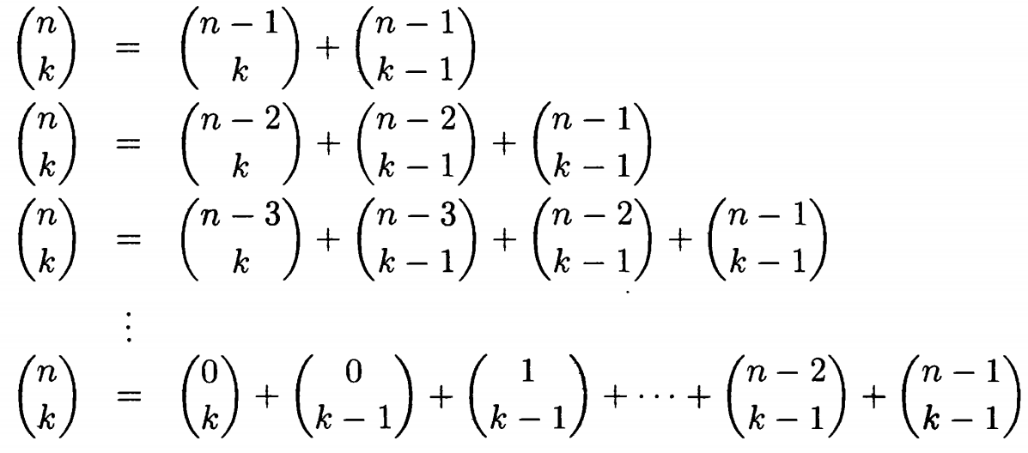
Formula 5.19

Slide 36
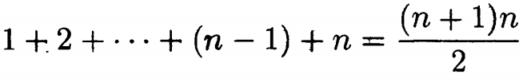
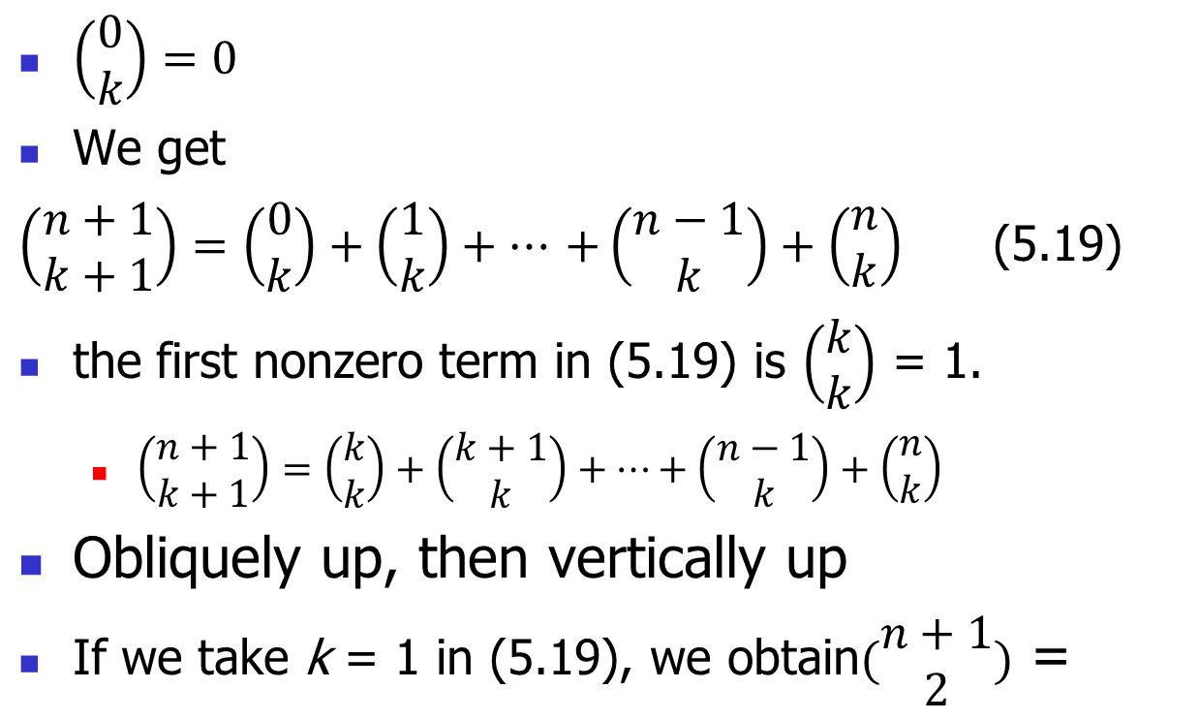
Formula 5.19
$\left(\begin{matrix}0 \\ k\end{matrix}\right)=0$
We get
$\left(\begin{matrix}n+1 \\ k+1\end{matrix}\right)=\left(\begin{matrix}0 \\ k\end{matrix}\right)+\left(\begin{matrix}1 \\ k\end{matrix}\right)+…$ $+\left(\begin{matrix}n−1 \\ k\end{matrix}\right)+\left(\begin{matrix}n \\ k\end{matrix}\right)$ (5.19)
the first nonzero term in (5.19) is $\left(\begin{matrix}k \\ k\end{matrix}\right)$ = 1.
$\left(\begin{matrix}n+1 \\ k+1\end{matrix}\right)=\left(\begin{matrix}k \\ k\end{matrix}\right)+\left(\begin{matrix}k+1 \\ k\end{matrix}\right)+…+\left(\begin{matrix}n−1 \\ k\end{matrix}\right)+\left(\begin{matrix}n \\ k\end{matrix}\right)$
Obliquely up, then vertically up
If we take k = 1 in (5.19), we obtain$(\begin{matrix}n+1 \\ 2\end{matrix})$ =

Slide 37
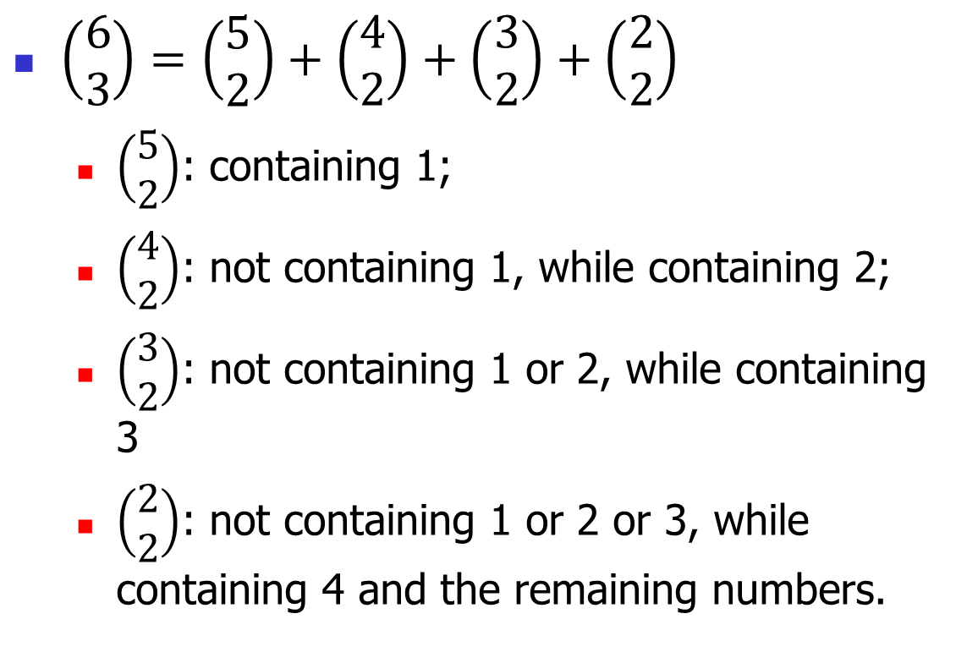
Intuitional Interpretation of Formula 5.19
$\left(\begin{matrix}6 \\ 3\end{matrix}\right)=\left(\begin{matrix}5 \\ 2\end{matrix}\right)+\left(\begin{matrix}4 \\ 2\end{matrix}\right)+\left(\begin{matrix}3 \\ 2\end{matrix}\right)+\left(\begin{matrix}2 \\ 2\end{matrix}\right)$
$\left(\begin{matrix}5 \\ 2\end{matrix}\right)$: containing 1;
$\left(\begin{matrix}4 \\ 2\end{matrix}\right)$: not containing 1, while containing 2;
$\left(\begin{matrix}3 \\ 2\end{matrix}\right)$: not containing 1 or 2, while containing 3
$\left(\begin{matrix}2 \\ 2\end{matrix}\right)$: not containing 1 or 2 or 3, while containing 4 and the remaining numbers.

Slide 38
5.3 Unimodality of Binomial Coefficients

Slide 39
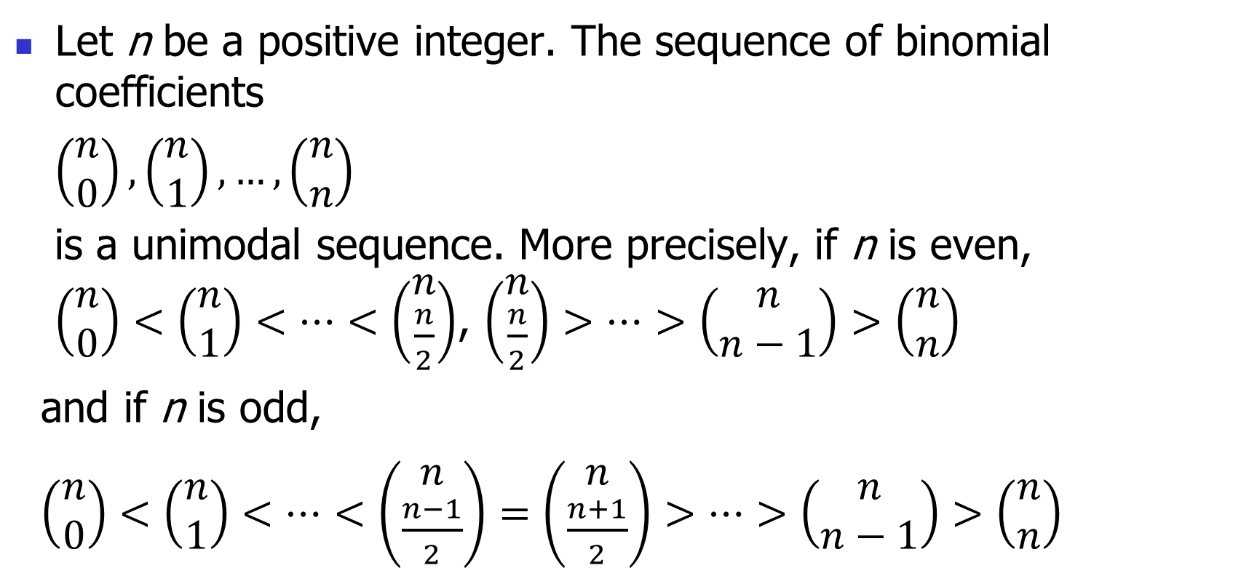
Theorem 5.3.1
Let n be a positive integer. The sequence of binomial coefficients
$\left(\begin{matrix}n \\ 0\end{matrix}\right),\left(\begin{matrix}n \\ 1\end{matrix}\right), …,\left(\begin{matrix}n \\ n\end{matrix}\right)$
is a unimodal sequence. More precisely, if n is even, $\left(\begin{matrix}n \\ 0\end{matrix}\right)<\left(\begin{matrix}n \\ 1\end{matrix}\right)<…<\left(\begin{matrix}n \\ \frac{n}{2}\end{matrix}\right)$, $\left(\begin{matrix}n \\ \frac{n}{2}\end{matrix}\right)>…>\left(\begin{matrix}n \\ n−1\end{matrix}\right)>\left(\begin{matrix}n \\ n\end{matrix}\right)$
and if n is odd,
$\left(\begin{matrix}n \\ 0\end{matrix}\right)<\left(\begin{matrix}n \\ 1\end{matrix}\right)<…<\left(\begin{matrix}n \\ \frac{n−1}{2}\end{matrix}\right)=\left(\begin{matrix}n \\ \frac{n+1}{2}\end{matrix}\right)>…>\left(\begin{matrix}n \\ n−1\end{matrix}\right)>\left(\begin{matrix}n \\ n\end{matrix}\right)$

Slide 40

Theorem 5.3.1
Proof
Evaluate the quotient of $\left(\begin{matrix}n \\ i\end{matrix}\right)$ and $\left(\begin{matrix}n \\ i+1\end{matrix}\right)$
Please refer to the proof on page 140(153/618) of the textbook.

Slide 41

Corollary 5.3.2
For n a positive integer, the largest of the binomial coefficients $\left(\begin{matrix}n \\ 0\end{matrix}\right),\left(\begin{matrix}n \\ 1\end{matrix}\right), …,\left(\begin{matrix}n \\ n\end{matrix}\right)$ is $\left(\begin{matrix}n \\ \left\lfloor n/2\right\rfloor \end{matrix}\right)=\left(\begin{matrix}n \\ \left\lceil n/2\right\rceil \end{matrix}\right)$,
where
$\left\lfloor x\right\rfloor$ is called the floor of x: the greatest integer that is less than or equal to x.
$\left\lceil x\right\rceil$ is called the ceiling of x: the smallest integer that is greater than or equal to x.

Slide 42
Antichain
An antichain of S is a collection A of subsets of S with the property that no subset in A is contained in another.
For example, if S={a, b, c, d}, then A = {{a, b},{b, c, d},{a, d},{a, c}} is an antichain.

Slide 43

Antichain
One way to obtain an antichain on a set S is to choose an integer k <= n and then take A_{k} to be the collection of all k-subsets of S.
It follows from Corollary 5.3.2, that such an antichain contains at most $\left(\begin{matrix}n \\ \left\lceil n/2\right\rceil \end{matrix}\right)$ sets.
For example, if n = 4 and S = {a, b, c, d}, the 2-subsets of S give the antichain C₂ = {{a, b}, {a, c}, {a, d}, {b, c}, {b, d}, {c, d}} of size 6.

Slide 44
Chain
A collection C of subsets of S is a chain provided that for that each pair of subsets in C, one is contained in the other:
Example. If n = 5 and S = {1, 2, 3, 4, 5},
{2} ⊂ {2,3,5} ⊂ {1,2,3,5}
∅ ⊂ {3} ⊂ {3,4} ⊂ {1,3,4} ⊂ {1,3,4,5} ⊂ {1,2,3,4,5}.
How about a subset with only one object?
Both antichain and chain: vacuous true.

Slide 45
A Maximal Chain
it is not possible to squeeze more subsets into the chain.
In general, if S = {1, 2, ... , n}, a maximal chain is a chain
where |A_{i}| = i for i = 0,1,2 ... , n. Each maximal chain of S is
obtained as follows:
(0) Start with the empty set.
(1) Choose an element i₁ in S to form A₁ = {i₁}.
(2) Choose an element i₂ <> i₁ to form A₂ = {i₁, i₂}.

Slide 46
A Maximal Chain
…
(k) Choose an element i_{k} <> i₁, i₂,…, i_{k-1} to form A_{k} = {i₁, i₂, … , i_{k}}.
…
(n) Choose an element i_{n} <> i₁, i₂,…, i_{n-1} to form A_{k} = {i₁, i₂, … , i_{n}}.
Carrying out these steps is equivalent to choosing a permutation i₁, i₂, … , i_{n} of {1, 2, ... ,n}, and there is a one-to-one correspondence between maximal chains of s = {1, 2, ... , n} and permutations of {1, 2, ... , n}.
The number of maximal chains equals n!.

Slide 47
A Maximal Chain
More generally, given any A ⊂ S with |A| = k, the number of maximal chains containing A equals k!(n - k)!
k! to get to A: all the sets precede A are subsets of A.
(n - k)! to get from A to {1, 2, ... , n}: all the sets succeed A are supersets of A.

Slide 48


Theorem 5.3.3 The Maximal Cardinality of An Antichain of A Set
Let S be a set of n elements. Then an antichain on S contains at most $\left(\begin{matrix}n \\ \left\lfloor n/2\right\rfloor \end{matrix}\right)$ sets.
Proof(Basic Idea)
The number of antichain on S should not be infinite, so what’s its upper bound?
Relation between chain and antichain: No two subsets of an antichain can exists in the same chain(represented by some maximal chains, the ‘some’ is k!(n - k)! ).
Number of maximal chains of S is definite: |S|!.
example
Antichain: ({x}, {y}, {z})
Antichain: ({x, y}, {z})

Slide 49

Theorem 5.3.3
Proof
Let A be an antichain. We count in two different ways the number β of ordered pairs (A_{i}, $C_{i_{j}}$) such that A_{i} is in A, $C_{i}$ is a set of maximal chains that contains A_{i} , and $C_{i_{j}}$ is an element of $C_{i}$.
each maximal chain contains at most one subset in the antichain A, for A_{i} <> A_{i}, C_{i} ∩C_{j} = φ.
β is at most the number of maximal chains; that is, β <= n!.

Slide 50


Theorem 5.3.3
Focusing now on one subset A_{i} in the antichain A, we know that, if |A_{i}| = k, there are at most k!(n - k)! maximal chains containing A_{i}.
Let α_{k} be the number of subsets in the antichain A of size k so that |A| = $\sum_{k=0}^{n}{\text{α}\text{k}}$ . Then
$β=\sum_{k=0}^{n}{\text{α}\text{k}}∗k!∗\left(n−k\right)!$
Since β <= n!, we calculate that

Slide 51

Theorem 5.3.3
$\left(\begin{matrix}n \\ k\end{matrix}\right)$ is maximum when $k=\left\lfloor n/2\right\rfloor$, and we get that
$\sum_{k=0}^{n}{\frac{α_{k}}{\left(\begin{matrix}n \\ k\end{matrix}\right)}∗\left(\begin{matrix}n \\ \left\lfloor \frac{n}{2}\right\rfloor \end{matrix}\right)≤1∗\left(\begin{matrix}n \\ \left\lfloor \frac{n}{2}\right\rfloor \end{matrix}\right)}$ =>
$\sum_{k=0}^{n}{α_{k}}≤\sum_{k=0}^{n}{\frac{α_{k}}{\left(\begin{matrix}n \\ k\end{matrix}\right)}∗\left(\begin{matrix}n \\ \left\lfloor \frac{n}{2}\right\rfloor \end{matrix}\right)≤1∗\left(\begin{matrix}n \\ \left\lfloor \frac{n}{2}\right\rfloor \end{matrix}\right)}$ =>
$|A|=\sum_{k=0}^{n}{α_{k}}≤\left(\begin{matrix}n \\ \left\lfloor \frac{n}{2}\right\rfloor \end{matrix}\right)$

Slide 52
4.5 Partial Orders and Equivalence Relations

Slide 53
Relations (for self study)
Let X be a set.
A relation on X is a subset R of the set X * X of ordered pairs of elements of X. We write aRb (a is related to b), provided that the ordered pair (a, b) belongs to R; we also write a ¬R b whenever (a, b) is not in R (a is not related to b) .

Slide 54
Special Properties of a Relation (for self study)
Reflexive: x R x for all x in X.
Irreflexive: x ¬R x for all x in X.
Symmetric: for all x and y in X, whenever we have x R y we also have y R x.
Antisymmetric: for all x and y in X with x <> y, whenever we have x R y, we also have y ¬R x. Equivalently, for all x and y in X, x R y and y R x together imply that x = y.
Transitive: for all x, y, z in X, whenever we have xRy and y R z, we also have x R z.

Slide 55
Partial Order (for self study)
A partial order on a set X is a reflexive, antisymmetric, and transitive relation R.
<=
A strict partial order on a set X is an irreflexive, antisymmetric, and transitive relation.
<
irreflexive & antisymmetric = asymmetric
A set X on which a partial order <= is defined is usually called a partially ordered set (or more simply, a poset) and denoted by (X, <=).

Slide 56
Comparability and Total Order (for self study)
If R is a relation on a set X, then for x and y in X, x and y are comparable, provided that either x R y or y R x; x and y are incomparable otherwise.
A partial order R on a set X is a total order, provided that every pair of elements of X is comparable.
reflexivity: for any element x of S, x≤x ;
transitivity: whenever x≤y≤z, then x≤z;
antisymmetry: whenever x≤y≤x, then x=y;
totality: for any x and y in S, x≤y or y≤x.
A linear order (also called pseudo-order, according to Wikipedia) is the irreflexive version of a total order.

Slide 57
Theorem 4.5.1 Total Order to Linear Order (for self study)
Let X be a finite set with n elements. Then there is a one-to-one correspondence between the total orders on X and the permutations of X. In particular, the number of different total orders on X is n!.
Proof
Obvious? How to construct a permutation from a total order?
induction on n that each total order <= on X corresponds to a permutation a₁, a₂, ... ,a_{n} of X with a₁ < a₂ < ... < a_{n}.

Slide 58
Theorem 4.5.1 (for self study)
If n = 1, this is trivial.
Let n > 1. We first show that there is a minimal element of X; that is, an element a₁ such that b <= a₁ implies that b = a₁ (equivalently, there is no element x with x < a₁).
Let a be any element of X. If a is not a minimal element, then there is an element b such that b < a.
If b is not a minimal element, there is an element c such that c < b so that c < b < a.
Continuing like this and using the fact that X is a finite set, eventually we locate a minimal element a₁.

Slide 59
Theorem 4.5.1 (for self study)
Applying induction to the set of n - 1 elements of X different from a₁, we conclude that these elements can be ordered a₂, a₃, ... , a_{n} with a₂ < a₃ < ... < a_{n}. Hence, a₁, a₂, a₃, ... , a_{n} is a permutation of the elements of X with a₁ < a₂ < a₃ < ... < a_{n}.

Slide 60
Represent Partially Ordered Set Geometrically
the cover relation of a partially ordered set (X, <=):
Let a and b be in X. Then a is covered by b (also expressed as b covers a), denoted a <_{c} b, provided that a < b and no element x can be squeezed between a and b; that is, there does not exist an element x such that both a < x and x < b hold.
If X is a finite set, then, by transitivity, the partial order <= is uniquely determined by its cover relation.

Slide 61

The Hasse Diagram
Example.
The set of the first eight positive integers, partially ordered by "is a divisor of," is represented by the diagram in Figure 4.8.
In 4 divided by 2, the number 2 is the divisor and 4 is the dividend.
Special case: It follows from Theorem 4.5.1 that, if (X,<=) is a totally ordered set, then the elements of X can be listed as a linearly ordered set x₁, x₂, ... , x_{n} such that x₁ <_{c} x₂ <_{c} … <_{c} x_{n}.

Slide 62

Relation between Partial Orders on the Same Set: Extension
Let $≤1$ and $≤2$ be two partial orders on the same set X. Then the partially ordered set (X, $≤2$) is an extension of the partially ordered set (X, $≤1$), provided that whenever a $≤1$b holds, a $≤2$b also holds.
more comparable pairs.

Slide 63
The Linear Extension
We show that every finite partially ordered set (X, <=) has a linear extension;
linearly ordered set.
This means that it is possible to list the elements of X in a linear order x₁, x₂, ... , x_{n} so that x_{i} is listed before x_{j} whenever x_{i} < x_{j}.

Slide 64
Theorem 4.5.2
Let (X,<=) be a finite partially ordered set. Then there is a linear extension of (X, <=).
Proof. There is a very simple algorithm for listing the elements of X in a linear order x₁, x₂, ... , x_{n} to obtain a linear extension of (X, <=):

Slide 65
Theorem 4.5.2
Algorithm for a linear extension of a partially ordered set
(1) Choose a minimal element x₁ of X (with respect to the partial order <=).
(2) Delete x₁ from X and choose a minimal element x₂ from among the remaining n - 1 elements.
(3) Delete x₂ from X and choose a minimal element x₃ from among the remaining n - 2 elements.
…
(n) Delete x_{n-1} from X, leaving exactly one element x_{n}.

Slide 66
Theorem 4.5.2
arguing by contradiction.
Suppose there are x_{i} and x_{j} such that x_{i} < x_{j} but j < i.
Then, in step (j) of the preceding algorithm, when we chose x_{j}, x_{i} was among the remaining elements, and since x_{i} < x_{j}, x_{j} was not a minimal element as required by the algorithm.

Slide 67
Example
Please construct a linear extension of the following poset.

Slide 68
Equivalence Relation (for self study)
A relation R on X is an equivalence relation provided that it is reflexive, symmetric, and transitive.
a generalization of equality "=" of numbers.
equivalence relations on X naturally correspond to partitions of X into nonempty sets.
Let ~ be an equivalence relation on X. For each a in X, the equivalence class of a is the set [a]={x: x~a} of all elements of X that are equivalent to a.

Slide 69
Theorem 4.5.3 (for self study)
Let ~ be an equivalence relation on a set X. Then the distinct equivalence classes partition X into nonempty parts. Conversely, given any partition of X into nonempty parts, there is an equivalence relation on X whose equivalence classes are the parts of the partition.
Proof
Please refer to the proof on page 118(131/618) of the textbook.

Slide 70
5.6 More on Partially Ordered Sets

Slide 71
In Section 5.3, we discussed the notions of antichain and chain in the special partially ordered set P(X) of all subsets of a set X.
In the current section, we extend these notions to partially ordered sets in general, and prove some basic theorems.

Slide 72
Chain & Antichain
It follows immediately from definitions that a subset of a chain is also a chain and that a subset of an antichain is also an antichain.
The important relationship between antichains and chains, following from their definitions, is that |A ∩ C| <= 1 if A is an antichain and C is a chain.

Slide 73
Partitions of a Set into Chains and Antichains
Surely, if there is a chain C of size r, then, since no two elements of C can belong to the same antichain, X cannot be partitioned into fewer than r antichains.
Similarly, if there is an antichain A of size s, then, since no two elements of A can belong to the same chain, X cannot be partitioned into fewer that s chains.
What’s the minimal cardinality of the two partition?

Slide 74
Theorem 5.6.1
Let (X, <=) be a finite partially ordered set, and let r be the largest size of a chain. Then X can be partitioned into r but no fewer antichains.

Slide 75
Theorem 5.6.1
Proof(basic idea)
If we represent the poset geometrically, and draw the cover relation using vertical or near vertical line segment, we can think of the chains as vertical or near vertical path, while the antichains as cuts of these path, which are horizontal or near horizontal.
How to partition X into antichains according to the chain with the largest size?

Slide 76
Proof of Theorem 5.6.1
it suffices to show that X can be partitioned into r antichains.
Let X₁ = X and let A₁ be the set of minimal elements of X.
All minimal elements of a partially ordered set forms an antichain, as does the set of all maximal elements.
Delete the elements of A₁ from X₁ to get X₂. Let A₂ be the set of minimal elements of X₂.
…
We continue like this until we get to the first integer p such that X_{p} <> 0 but X_{p+1} = 0. Then A₁, A₂, ... , A_{p} is a partition of X into antichains.

Slide 77

Proof of Theorem 5.6.1
Diagrammatically, we have
where for each element of A_{j} there is an element of A_{j-1}
below it in the partial order (2 <= j <= p).
Starting with an element a_{p} of A_{p} , we can obtain a chain a₁ < a₂ < ... < a_{p}, where a₁ is in A₁, a₂ is in A₂, … , a_{p} is in A_{p}.

Slide 78
Proof of Theorem 5.6.1
Since r is the largest size of a chain, r >= p. Since X is partitioned into p antichains, r <= p. Hence r = p and the theorem is proved.
It is suffice to prove that for a chain C of size r, it has exactly one element belongs to each A_{i} (1 <= i <= p), and there is no element of C that does not belong to any A_{i}(1 <= i <= p).

Slide 79
Theorem 5.6.2
Let (X, <=) be a finite partially ordered set, and let m be the largest size of an antichain. Then X can be partitioned into m but no fewer chains.
Proof(basic idea)
How to construct a set of chains according to the antichain of the largest size?(intuitionally?)

Slide 80
There is an antichain A of size m that is neither the set of all maximal elements nor the set of all minimal elements of X.
Let A⁺ = {x : x in X with a <= x for some a in A},A⁻ = {x : x in X with x <= a for some a in A}.
1. A⁺ <> X (and thus |A⁺| < |X|),
2. A⁻ <> X (and thus |A⁻| < |X|),
3. A⁺ ∩ A⁻ = A, 4. A⁺ ∪ A⁻ = X,
A⁺ can be partitioned into m chains E₁, E₂, ... , E_{m}, and A⁻ can be partitioned into m chains F₁, F₂, ... , F_{m}

Slide 81
Proof of Theorem 5.6.2
It suffices to show that X can be partitioned into m chains.
We prove this by induction on the number n of elements in X.
If n = 1, then the conclusion holds trivially.
Assume that n > 1.
Case 1. There is an antichain A of size m that is neither the set of all maximal elements nor the set of all minimal elements of X.
Let A⁺ = {x : x in X with a <= x for some a in A},
A⁻ = {x : x in X with x <= a for some a in A}.

Slide 82
Proof of Theorem 5.6.2
Relations of A⁺, A⁻ and X.
1. A⁺ <> X (and thus |A⁺| < |X|), since there is a minimal element not in A;
2. A⁻ <> X (and thus |A⁻| < |X|), since there is a maximal element not in A;
3. A⁺ ∩ A⁻ = A, since, if there were an element x in A⁺ ∩ A⁻ not in A, then we would have a₁ < x < a₂ for some elements a₁ and a₂ in A, contradicting the assumption that A is an antichain;
4. A⁺ ∪ A⁻ = X, since, if there were an element x not in A⁺ ∪ A⁻, A ∪{x} would be an antichain of larger size than A.

Slide 83
Proof of Theorem 5.6.2
We apply the induction assumption to the smaller partially ordered sets A⁺ and A⁻ and conclude that A⁺ can be partitioned into m chains E₁, E₂, ... , E_{m}, and A⁻ can be partitioned into m chains F₁, F₂, ... , F_{m}.
The elements of A are the maximal elements of A⁻ and so the last elements on the chains F₁, F₂, ... , F_{m};
the elements of A are also the minimal elements of A⁺ and so the first elements on the chains E₁, E₂, ... , E_{m}.
We "glue" the chains together in pairs to form m chains that partition X.

Slide 84
Proof of Theorem 5.6.2
Case 2
There are at most two antichains of size m, and these are one or both of the set of all maximal elements and the set of all minimal elements.
Let x be a minimal element and y a maximal element with x <= y (x may equal y).
Then the largest size of an antichain of X - {x, y} is m - 1. By the induction hypothesis, X - {x, y} can be partitioned into m - 1 chains. These chains, together with the chain x <= y, give a partition of X into m chains.

Slide 85

Partition of Power Set into Chains
Inductive Observation
n = 1
n = 2

Slide 86
Partition of Power Set into Chains

Slide 87
Partition of Power Set into Chains
n=4

Slide 88
Partition of Power Set into Chains
n=4 ?
for each chain got when n=3
(1) The first obtained by attaching at the end, the subset obtained by appending 4 to the last subset of the chain,
(2) The second obtained by appending 4 to all but the last subset of the chain (and deleting that last subset).

Slide 89
Symmetric Chain Partition
A chain partition of the subsets of {1, 2, ... , n} is a symmetric chain partition, provided that
(1) Each subset in a chain has one more element than the subset that precedes it in the chain; and
(2) The size of the first subset in a chain plus the size of the last subset in the chain equals n. (If the chain contains only one subset, then it is both first and last, so twice its size is n; that is, its size is n/2 and n is even.)

Slide 90

Symmetric Chain Partition
Each chain in asymmetric chain partition must contain exactly one $\left\lfloor n/2\right\rfloor$-subset (and exactly one $\left\lceil n/2\right\rceil$-subset); hence, the number of chains in a symmetric chain partition equals $\left(\begin{matrix}n \\ \left\lfloor n/2\right\rfloor \end{matrix}\right)=\left(\begin{matrix}n \\ \left\lceil n/2\right\rceil \end{matrix}\right).$

Slide 91
Inductive Construction of Symmetric Chain Decomposition
A symmetric chain decomposition for {1, 2, ... ,n} can be obtained inductively from a symmetric chain decomposition of {1, 2, ... , n - 1}, as previously illustrated for n = 3.
We take each chain
A₁ ⊂ A₂ ⊂ … ⊂ A_{k}, where |A₁ | + |A_{K} | = n - 1
in a symmetric chain partition for {1, 2, ... , n - 1} and,
depending on whether k = 1 or > 1, obtain one or two chains
for {1, 2, ... , n}:

Slide 92

Inductive Construction of Symmetric Chain Decomposition
A₁ ⊂ A₂ ⊂ … ⊂ A_{k} U {n}, where |A| + |A_{k} U {n}| = n, and
A₁ U {n} ⊂ A₂ U {n} ⊂ … ⊂ A_{k-1} U {n} where |A₁ U {n}| +
|A_{k-1} U {n}| = n.
The number of chains in a symmetric chain partition of {1, 2, ... ,n} is $\left(\begin{matrix}n \\ \left\lfloor n/2\right\rfloor \end{matrix}\right)$.
Thus, the number of subsets in an antichain of {1, 2, ... , n} is at most equal to $\left(\begin{matrix}n \\ \left\lfloor n/2\right\rfloor \end{matrix}\right)$: select one subset from each chain.
Thus we have a more "constructive" proof of Sperner's theorem.

Slide 93
5.4 The Multinomial Theorem

Slide 94

Theorem 5.4.1
Let n be a positive integer. For all x₁, x₂, … , x_{t} ,
where the summation extends over all nonnegative integral
solutions n₁, n₂, ... , n_{t}, of n₁ + n₂ + ... + n_{t} = n.

Slide 95

The Multinomial Theorem
The number of different terms that occur in the multinomial expansion of (x₁ + x₂ + ... + x_{t} )^{n} equals the number of nonnegative integral solutions of n₁ + n₂ + ... + n_{t} = n.
$\left(\begin{matrix}n+t −1 \\ n\end{matrix}\right)$
Combination of multiset with infinite supply.
For a prescribed combination of {n₁, n₂, …, n_{t}} with n₁ + n₂ + ... + n_{t} = n, there is $\frac{n!}{n_{1}!n_{2}! …{ n}_{t}!}$ terms of $x_{1}^{n_{1}}x_{2}^{n_{2}}…x_{t}^{n_{t}}$, which is equal to the permuatation of {n₁ • x₁, n₂ • x₂, …, n_{t} • x_{t}}

Slide 96



Theorem 5.4.1
Proof
We generalize the first proof of the binomial theorem.
We obtain the term $x_{1}^{n_{1}}x_{2}^{n_{2}}…x_{t}^{n_{t}}$ by choosing x₁ in n₁ of the n factors, x₂ in n₂ of the remaining n – n₁ factors, ... , x_{t} in n_{t} of the remaining n – n₁ - ... - n_{t-1} factors.
By the multiplication principle:
this number equals the multinomial coefficient

Slide 97

Multinomial Coefficients
$\left(\begin{matrix}n \\ n_{1} n_{2} … n_{t}\end{matrix}\right)= \frac{n!}{n_{1}!n_{2}! …{ n}_{t}!}$
Here, n₁, n₂,…,n_{t} are nonnegative integers with n₁ + n₂ + … + n_{t} = n.
Full permutation of multiset ({n₁ • a₁, n₂ • a₂, … , n_{t} • a_{t}}) with finite supply.

Slide 98

Example
When (x₁ + x₂ + x₃ + x₄ + x₅)⁷ is expanded, the coefficient of x₁²x₃x₄³x₅ equals $\left(\begin{matrix}7 \\ 2 0 1 3 1\end{matrix}\right)=\frac{7!}{2!∗0!∗1!∗3!∗1!}=420$.
When (2x₁ – 3x₂ + 5x₃)⁶ is expanded, the coefficient of x₁³x₂x₃² equals $\left(\begin{matrix}6 \\ 3 1 2\end{matrix}\right) ∗23 ∗\left(−3\right)∗52=−36,000.$

Slide 99

Exercise 24
Consider a three-dimensional grid whose dimensions are 10 by 15 by 20. You are at the front lower left corner of the grid and wish to get to the back upper right corner 45 "blocks" away. How many different routes are there in which you walk exactly 45 blocks?
$\left(\begin{matrix}10+15+20 \\ 10\end{matrix}\right)\left(\begin{matrix}15+20 \\ 15\end{matrix}\right)=\frac{\left(10+15+20\right)!}{10!\left(15+20\right)!}\frac{\left(15+20\right)!}{\left(15\right)!(20)!}=\frac{\left(10+15+20\right)!}{10!15!20!}$

Slide 100


Pascal's Formula for the Multinomial Coefficients
$\left(\begin{matrix}n \\ k\end{matrix}\right)= \frac{n!}{k!(n−k)! }=\left(\begin{matrix}n \\ k (n−k)\end{matrix}\right)$
Pascal’s Formula for the binomial coefficients:
$$\left(\begin{matrix}n \\ k (n−k)\end{matrix}\right)=\left(\begin{matrix}n−1 \\ k (n−k −1)\end{matrix}\right)+\left(\begin{matrix}n−1 \\ (k −1) (n−k)\end{matrix}\right)$$
Pascal's formula for the multinomial coefficients is

Slide 101

Pascal's Formula for the Multinomial Coefficients
Proof (Method 1)
by direct substitution
For instance, let t = 3

Slide 102
Pascal's Formula for the Multinomial Coefficients
Proof (Method 2)
Consider the permutations of a multiset of objects of t different types with repetition numbers n₁, n₂, ... , n_{t}, respectively. Partition these permutations according to what type of object is in the first position.

Slide 103
Summary
The binomial theorem
Some additional Identities about combination number
Newton's binomial theorem
Pascal's Triangle and some relavant recurrence relation
Unimodality of binomial coefficients
Chain and antichain
The multinomial theorem

Slide 104
作业
自己练习，不做到作业本中
Pascal’s Formula: 1,
Multinomial theorem: 37, 38, 41
作业，上交
Pascal’s Formula: 2,
The binomial theorem: 4, 5, 6, 7, 11, 12, 36,
Extended binomial coefficients: 14, 22
Recurrence relation of combination number: 19,
Combination number: 23,
Chain and antichain: 33, 35, 48
Multinomial theorem: 39,
Newton’s binomial theorem: 46,

